Slide 1
Wavelets and
Multiresolution Processing
Deepak Kumar Rout

Slide 2
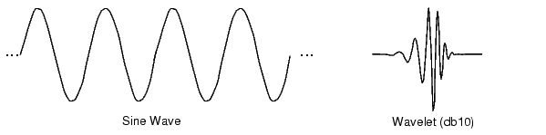
Preview
Fourier transform
  Basis functions are sinusoids
Wavelet transform 小波
  Basis functions are small waves, of varying frequency and limited duration

Slide 3
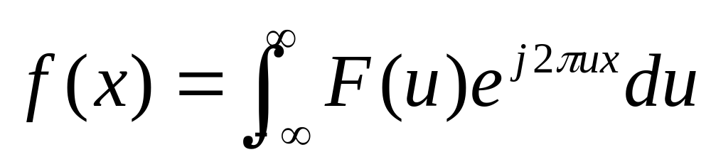
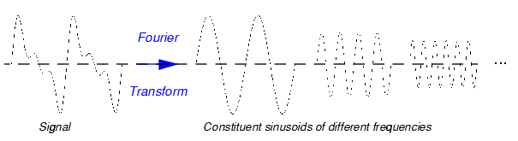
Signal representation (1)
Fourier transform
Sinusoid has unlimited duration

Slide 4
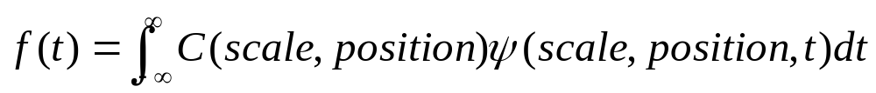
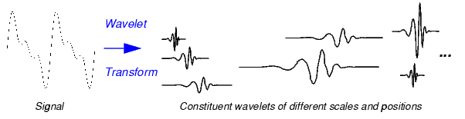
Signal representation (2)
Wavelet transform
A wavelet has compact support (limited duration)

Slide 5
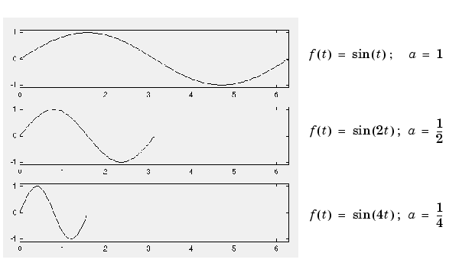
Scaling (1)
What is the scale factor?
Ex#1: Plot the above diagrams (hint: plot command)

Slide 6
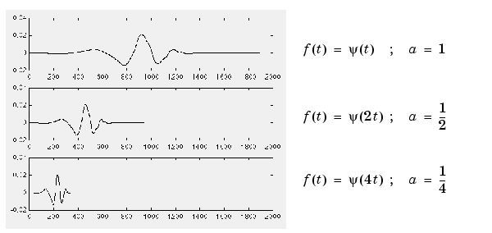
Scaling (2)
Scaling for wavelet function

Slide 7
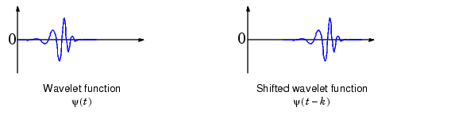
Shift
Shift for wavelet function

Slide 8
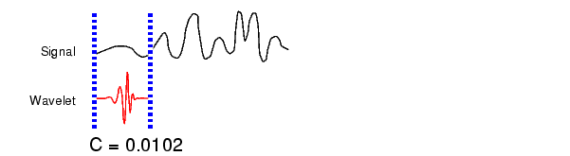
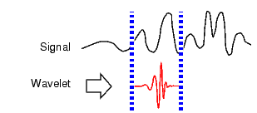
Steps to compute a continuous wavelet transform
Take a wavelet and calculate its similarity to the original signal
Shift the wavelet and repeat

Slide 9
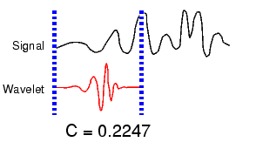
Steps to compute a continuous wavelet transform (2)
Scale the wavelet and repeat

Slide 10
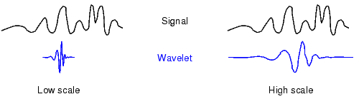
Scale and frequency
Rapid change
High frequency
Slow change
Low frequency

Slide 11
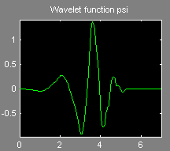
Continuous wavelet analysis
Matlab command
  wavemenu
  Continuous wavelet 1-D
  File => Load Signal
  (toolbox/wavelet/
  wavedemo/noissin.mat)
  db4, scale 1:48
  Zoom in details
(wavelet display button)

Slide 12
Discrete wavelet transform
Continuous wavelet transform: calculate wavelet coefficient at every possible scale and shift
Discrete wavelet transform: choose scale and shift on powers of two (dyadic scale and shift)
  Fast wavelet transform exist
  Perfect reconstruction

Slide 13
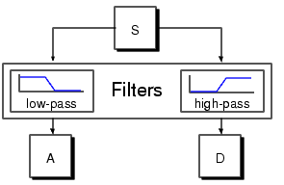
Filtering structure for wavelet transform
S. Mallat[89] derived the subband filtering structure for wavelet transform
Approximation
Detail

Slide 14
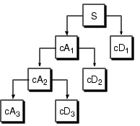
Multi-level decomposition
Wavelet decomposition tree
Low pass
filters
High pass
filters
L
H
L
H
2
2
L
H
2
2
L
H

Slide 15
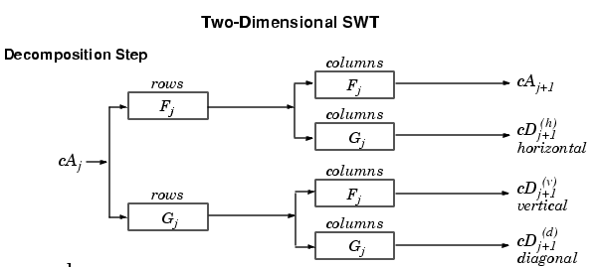
Two-dimensional wavelet transform

Slide 16
MATLAB: 2d SWT (Stationary Wavelet Transform)
load noiswom
[swa, swh, swv, swd]=swt2(X, 1, 'db1');
Ex#2: show the swa, swh, swv, swd
A0=iswt2(swa, swh, swv, swd, 'db1');
err=max(max(abs(X-A0)));
nulcfs=zeros(size(swa));
A1=iswt2(swa, nulcfs, nulcfs, nulcfs, 'db1');

Slide 17
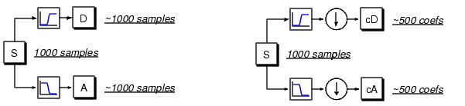
DWT with downsampling
Twice of the original data

Slide 18
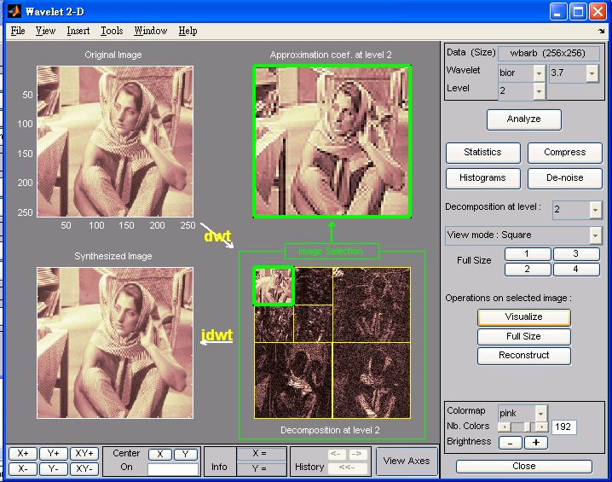
DWT using Matlab
wavemenu
Choose wavelet 2-D
Load image -> toolbox/wavelet/wavedemo/wbarb.mat
Bior3.7, level 2
Square and tree mode

Slide 19

Ex#3: DWT of iris image
Download the iris16.bmp
Download the iris normalization sample code
Generate the normalized iris image
Truncate to 56x512 image, save as .mat file
Use db2, 4 level wavelet analysis in the wavemenu tool
56
64
512

Slide 20
Matlab: one-level DWT functions
load wbarb
Single level decomposition
[cA1, cH1, cV1, cD1]=dwt2(X,'bior3.7');
Construct from approximation or details
A1=upcoef2('a', cA1, 'bior3.7', 1);
A1=idwt2(cA1, [],[],[], 'bior3.7', size(X));
Xfull=idwt2(cA1,cH1,cV1,cD1, 'bior3.7');
Ex#4: reconstruct from cH1, cV1, and cD1 respectively and show them all

Slide 21
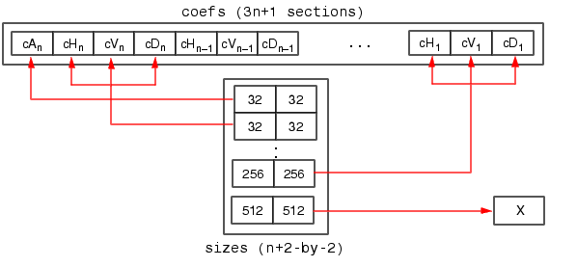
Matlab: multilevel DWT
[C, S]=wavedec2(X, 2, 'bior3.7');
C
S
Bookkeeping matrix

Slide 22
Matlab: multilevel DWT (2)
cA2=appcoef2(C,S,'bior3.7', 2);
cH2=detcoef2('h',C,S,2);
EX#5: Show all cA2, cH2, cV2, cD2, cH1, cV1, cD1
Reconstruction
X0=waverec2(C,S,'bior3.7');

